Slide 1


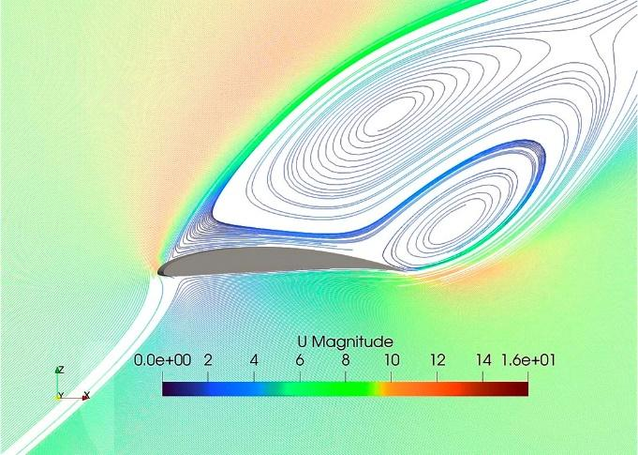
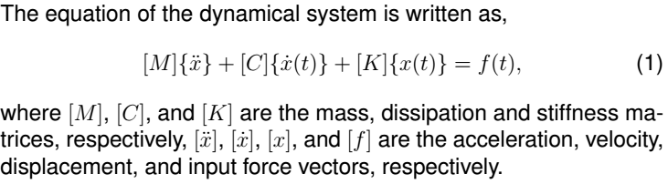


TiTLe
Authors (presenter’s name must be underlined)
Author’s affiliation
Abstract
This file must be used as a template for the presentations in the poster sections of SEAM 2024.
The content must be written in English and printed in poster format (1.2 m high and 0.9 m wide) in Calibri Corpo font, size 34 and justified, except for the title, author names, emails and subtitles, which must follow the template.
Materials and methods
Result 2
The poster presentation must address the following topics in a concise and objective manner: Introduction, Materials and/or Experimental and/or Numerical Methods, Results and Discussion, and Conclusions. The Acknowledgments and References sections are optional. Authors are responsible for bringing the poster already printed.
Equations can be typed or inserted into the text as an image:
The margins of the text fields must be 25 mm on the left and right and 10 mm on the top and bottom.
Keep a space of 30 mm between the text and the page margins. The width of the text must be 410 mm.
Figura 1. Distribuição das tensões normais durante a retificação de um canal reto e um helicoidal
Conclusion
Results
conclusion 1,
conclusion 2,
.....
The most important results are ideally presented in figures or tables.
Acknowledgments
Result 1
.....
Table 1 – Enumerate the figures in the order in which they appear, centered in relation to the text box.
References
Example
text | unit | value
Length | m | 1.5
Obs.: Format the table in two columns if necessary.
BRUNATTO, Silvio Francisco et al. Martensitic Stainless Steel: Direct Current Low-Temperature Plasma Carburizing. In: COLÁS, Rafael; TOTTEN, George E. (Org.). Encyclopedia of Iron, Steel, and Their Alloys. New York: CRC Press: Taylor & Francis, v. 1-5, p. 2153-2168, 2016. Doi: 10.1081/E-EISA-120051667.
COSTA e SILVA, André da; MEI, Paulo Roberto. Aços e Ligas Especiais. 3^{a.} ed. São Paulo: Editora Blucher Ltda., 2010. 646p.
SCHEUER, Cristiano José et al. Sequential low-temperature plasma-assisted thermochemical treatments of the AISI 420 martensitic stainless steel. Surface and Coatings Technology, v. 421, p. 127459, 2021. Doi: 10.1016/j.surfcoat.2021.127459.
Presenter
Presenter’s name
Occupation/Department/Faculty
University
E-mail address
Organized by

